Slide 1

CSE (H) with specialization in Machine Learning and Artificial Intelligence
Soft Computing
Chapter -2.3
By: Dr. Monika Singh E11032
DISCOVER . LEARN . EMPOWER

Slide 2
Course Objectives
To introduce soft computing concepts and techniques of artificial neural networks, fuzzy sets, fuzzy logic and genetic algorithms
To understand the various techniques from the application point of view.
To analyze various soft computing techniques and decide the technique to be used in a particular problem situation.
To implement soft computing based solutions for real-world problems

Slide 3
Course Outcomes
CO1 | Identify and describe soft computing techniques and their roles in building intelligent. Machines | 1
CO2 | Recognize the feasibility of applying a soft computing methodology for a particular problem. | 2,4
CO3 | Apply fuzzy logic and reasoning to handle uncertainty and solve engineering problems, genetic algorithms to combinatorial optimization problems and neural networks to pattern classification and regression problems. | 3
CO4 | Effectively use modern software tools to solve real problems using a soft computing approach. | 3
CO5 | Evaluate various soft computing approaches for a given problem. | 4

Slide 4
What are GANs?
System of two neural networks competing against each other in a zero-sum game framework.
They were first introduced by Ian Goodfellow et al. in 2014.
Can learn to draw samples from a model that is similar to data that we give them.
Notes:
Unsupervised Machine Learning
System of two neural networks competing against each other in a zero sum game framework
Introduced in 2014 by Ian Goodfellow
Generative and Discriminative
Draw samples from a model that is similar to the data given to it

Slide 5

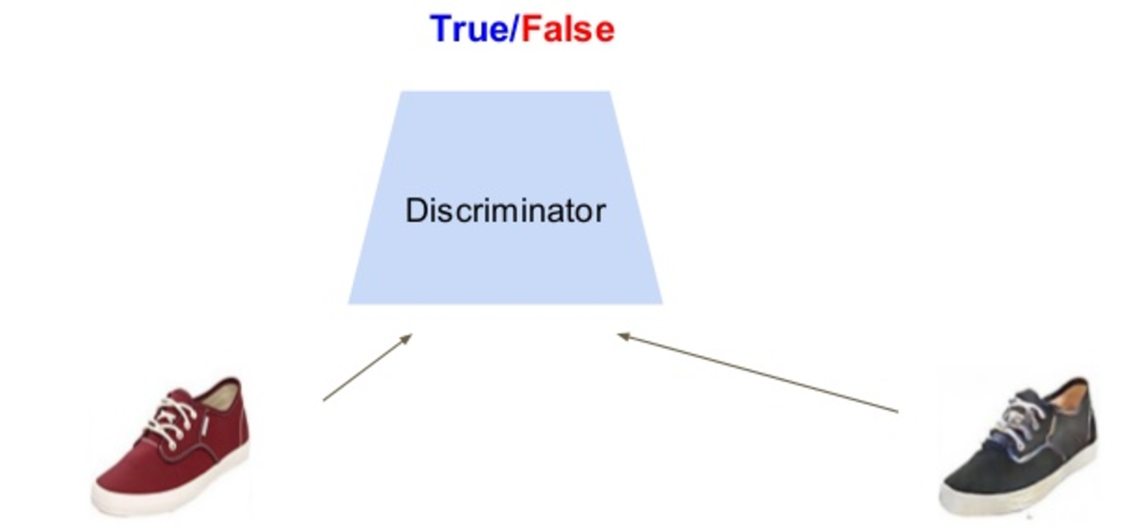
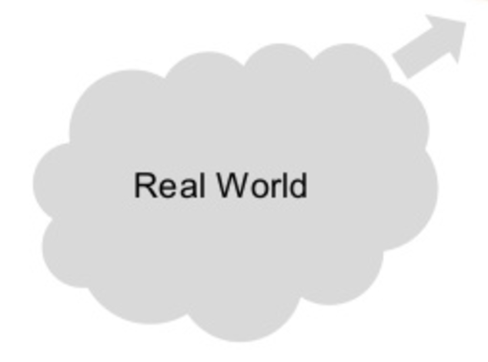
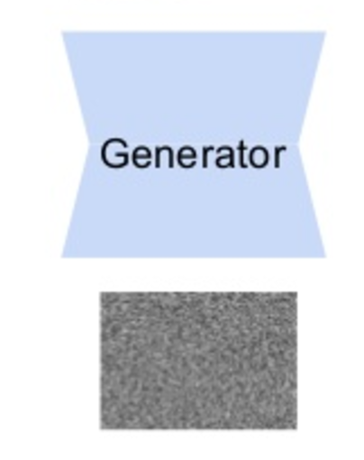
Components of GANs
Noise

Slide 6
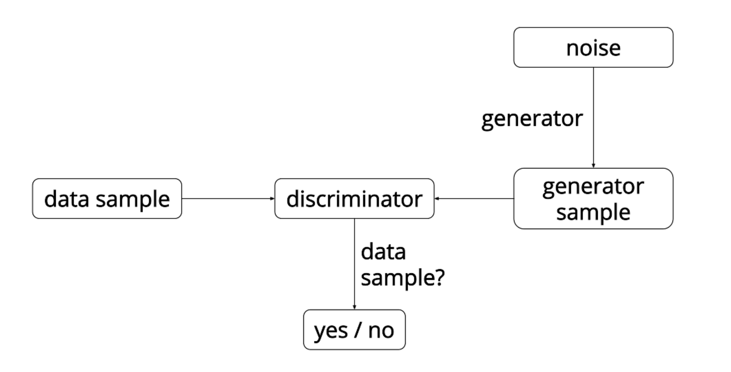
Overview of GANs
Source: https://ishmaelbelghazi.github.io/ALI

Slide 7
Discriminative Models
A discriminative model learns a function that maps the input data (x) to some desired output class label (y).
In probabilistic terms, they directly learn the conditional distribution P(y|x).
Notes:
1. Examples – SVMs, Logistic Regression

Slide 8
Generative Models
A generative model tries to learn the joint probability of the input data and labels simultaneously i.e. P(x,y).
Potential to understand and explain the underlying structure of the input data even when there are no labels.
Notes:
1. This can be converted to P(y|x) for classification via Bayes rule, but the generative ability could be used for something else as well, such as creating likely new (x, y) samples.

Slide 9
How GANs are being used?
Applied for modelling natural images.
Performance is fairly good in comparison to other generative models.
Useful for unsupervised learning tasks.
Notes:
Other generative models – Naïve Bayes, Hidden Markov model etc.
MLE estimates – Fixed set – Map to real world data – Select best set of parameters.

Slide 10
Why GANs?
Use a latent code.
Asymptotically consistent (unlike variational methods) .
No Markov chains needed.
Often regarded as producing the best samples.
Notes:
1. Asymptotically stable – Related to convergence – equilibrium points as t goes to infinity

Slide 11
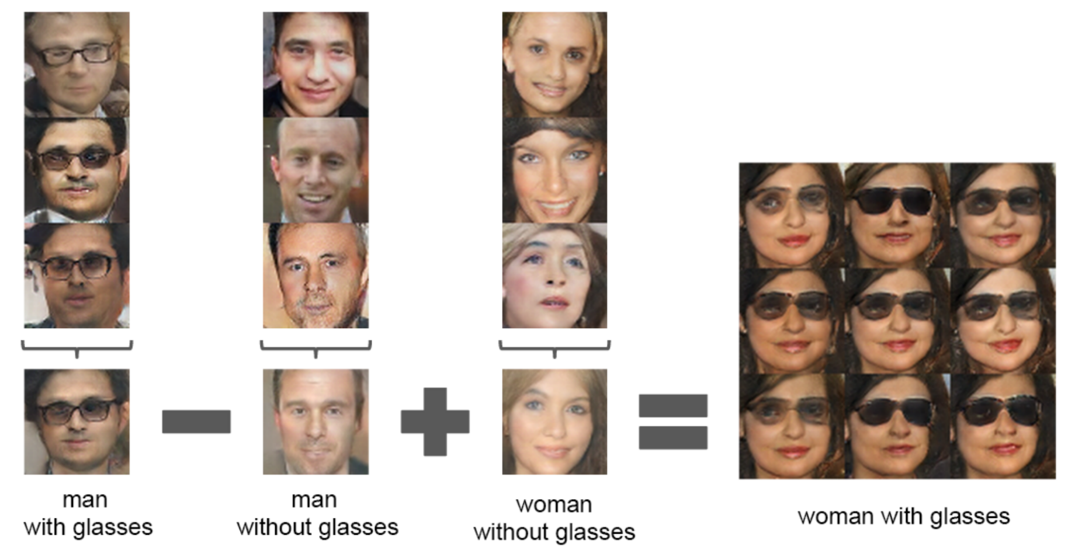

Slide 12
How to train GANs?
Objective of generative network - increase the error rate of the discriminative network.
Objective of discriminative network – decrease binary classification loss.
Discriminator training - backprop from a binary classification loss.
Generator training - backprop the negation of the binary classification loss of the discriminator.
Notes:
Generator is typically a deconvolutional neural network, and the discriminator is a convolutional neural network.
Goal – Find a setting of parameters that makes generated data look like the training data to the discriminator network.

Slide 13
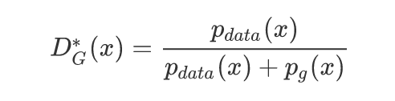
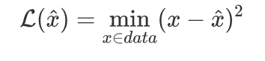
Loss Functions
Generator
Discriminator

Slide 14
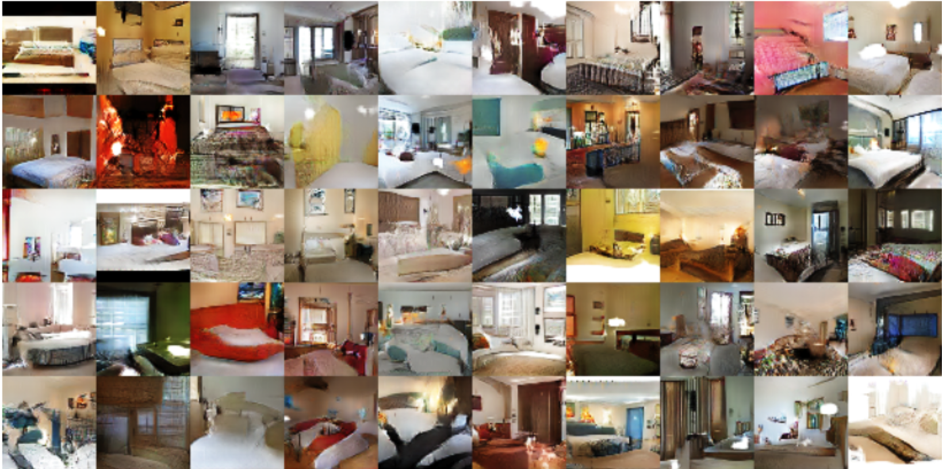
Generated bedrooms. Source: “Unsupervised Representation Learning with Deep Convolutional Generative Adversarial Networks” https://arxiv.org/abs/1511.06434v2

Slide 15
“Improved Techniques for Training GANs” by Salimans et. al
One-sided Label smoothing - replaces the 0 and 1 targets for a classifier with smoothed values, like .9 or .1 to reduce the vulnerability of neural networks to adversarial examples.
Virtual batch Normalization - each example x is normalized based on the statistics collected on a reference batch of examples that are chosen once and fixed at the start of training, and on x itself.
Notes:
Batch normalization greatly improves optimization of neural networks, and was shown to be highly effective for DCGANs.
It causes the output of a neural network for an input example x to be highly dependent on several other inputs x 0 in the same minibatch.
The reference batch is normalized using only its own statistics. VBN is computationally expensive because it requires running forward propagation on two minibatches of data, so we use it only in the generator network

Slide 16
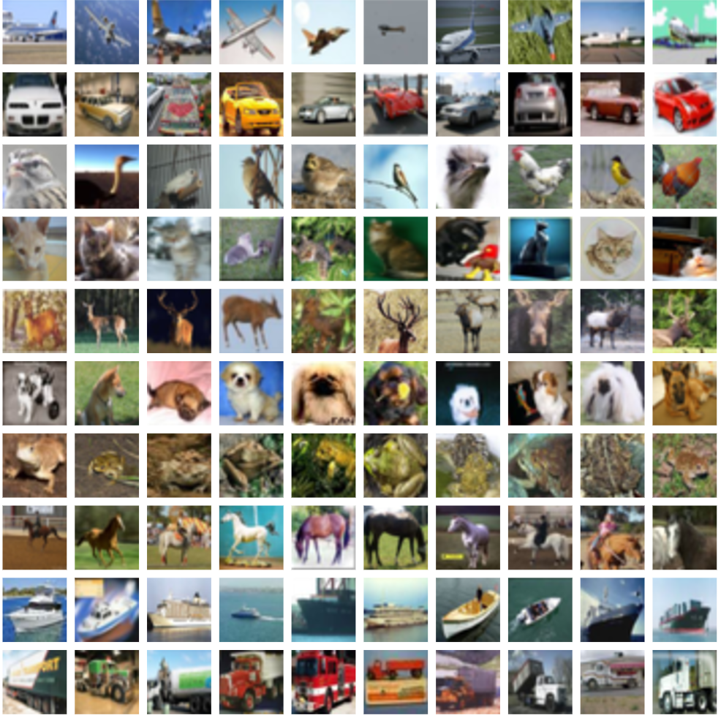
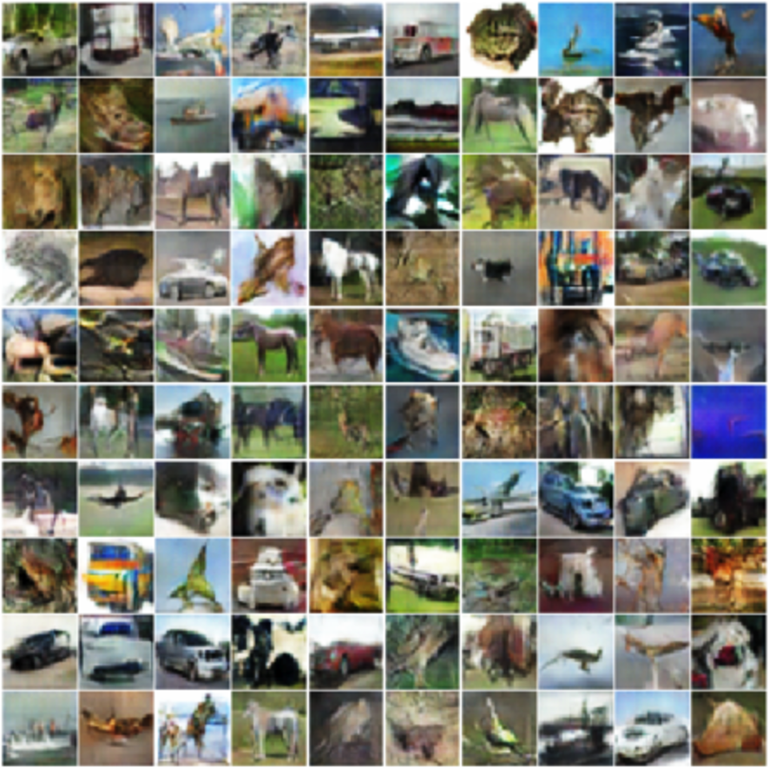
Original CIFAR-10 vs. Generated CIFAR-10 samples
Source: “Improved Techniques for Training GANs” https://arxiv.org/abs/1606.03498

Slide 17
Variations to GANs
Several new concepts built on top of GANs have been introduced –
InfoGAN – Approximate the data distribution and learn interpretable, useful vector representations of data.
Conditional GANs - Able to generate samples taking into account external information (class label, text, another image). Force G to generate a particular type of output.

Slide 18
Major Difficulties
Networks are difficult to converge.
Ideal goal – Generator and discriminator to reach some desired equilibrium but this is rare.
GANs are yet to converge on large problems (E.g. Imagenet).
Notes:
1. “On small problems, they sometimes converge and sometimes don’t. On large problems, like modeling ImageNet at 128x128 resolution, I’ve never seen them converge yet.” – Ian Goodfellow

Slide 19
Common Failure Cases
The discriminator becomes too strong too quickly and the generator ends up not learning anything.
The generator only learns very specific weaknesses of the discriminator.
The generator learns only a very small subset of the true data distribution.
Notes:
1. The discriminator classifies generated data as fake so accurately and confidently that there is nothing in the discriminator’s back-propagated loss function gradients for the generator to learn.
2. Takes advantage of these to trick the discriminator into classifying generated data as real instead of learning to represent the true data distribution.
3. An example of this occurring in practice is the case where for every possible input, the generator is generating the same data sample and there is no variation among it’s outputs.

Slide 20
So what can we do?
Normalize the inputs
A modified loss function
Use a spherical Z
BatchNorm
Avoid Sparse Gradients: ReLU, MaxPool
Use Soft and Noisy Labels
DCGAN / Hybrid Models
Track failures early (D loss goes to 0: failure mode)
If you have labels, use them
Add noise to inputs, decay over time
Notes:
normalize the images between -1 and 1. Tanh as the last layer of the generator output.
min (log 1-D) vanishing gradients early on. Use max log D. Flip labels when training generator: real = fake, fake = real
Sample from a gaussian distribution instead of a Uniform distribution
Construct different mini-batches for real and fake, i.e. each mini-batch needs to contain only all real images or all generated images.
the stability of the GAN game suffers if you have sparse gradients
Label Smoothing, i.e. if you have two target labels: Real=1 and Fake=0, then for each incoming sample, if it is real, then replace the label with a random number between 0.7 and 1.2, and if it is a fake sample, replace it with 0.0 and 0.3 (for example).

Slide 21
Conclusions
Train GAN – Use discriminator as base model for transfer learning and the fine-tuning of a production model.
A well-trained generator has learned the true data distribution well - Use generator as a source of data that is used to train a production model.

Slide 22
References
https://tryolabs.com/blog/2016/12/06/major-advancements-deep-learning-2016/
https://blog.waya.ai/introduction-to-gans-a-boxing-match-b-w-neural-nets-b4e5319cc935#.6l7zh8u50
https://en.wikipedia.org/wiki/Generative_adversarial_networks
http://blog.aylien.com/introduction-generative-adversarial-networks-code-tensorflow/
https://github.com/soumith/ganhacks

Slide 23
THANK YOU
For queries
Email: monika.e11032@cumail.in

